Slide 1
Hausa–English Dictionary Web App
Group 7

Slide 2
Git-Hub link
https://github.com/NasirIsmail341/Group-7-open-source.git

Slide 3
Group Members github link: https://github.com/NasirIsmail341/Group-7-open-source.git
S/N |  | Names | Reg. Numbers
1. |  | Yahya Ibrahim Muazzam | FCP/CSE/22/2001
2. |  | Ibrahim Safiyan | FCP/CSE/19/2003
3. |  | Ibrahim Auwal Ali | FCP/CSE/20/1068
4. |  | Saminu Ali | FCP/CSE/22/2004
5. |  | Sa’adat Usman | FCP/CSE/22/2009
6. |  | Khalid Fatima Abdullahi | FCP/CSE/22/2005
7. |  | Suleiman Dahiru | FCP/CSE/22/2002
8. |  | Ahmad Mukhtar | FCP/CSE/20/1070
9. |  | Teslim Raji | FCP/CSE/201069
10. |  | Nasir Ismail Umar | FCP/CSE/20/1071

Slide 4
Problem Statement
• Many students and community members face challenges in quick Hausa–English translations.
• Existing tools are heavy, require internet, or miss local usage.
• Need: Simple, lightweight, offline-friendly, open-source web app.

Slide 5
Objectives & Scope
• Search Hausa → English and English → Hausa.
• Mobile-friendly design (HTML + CSS + optional JS).
• Starter dictionary (20–50 words).
• Open-source contributions via GitHub.

Slide 6
Tools & Technologies
• Frontend: HTML, CSS.
• Optional: JavaScript (search).
• Version Control: Git & GitHub.
• Hosting: GitHub Pages.

Slide 7
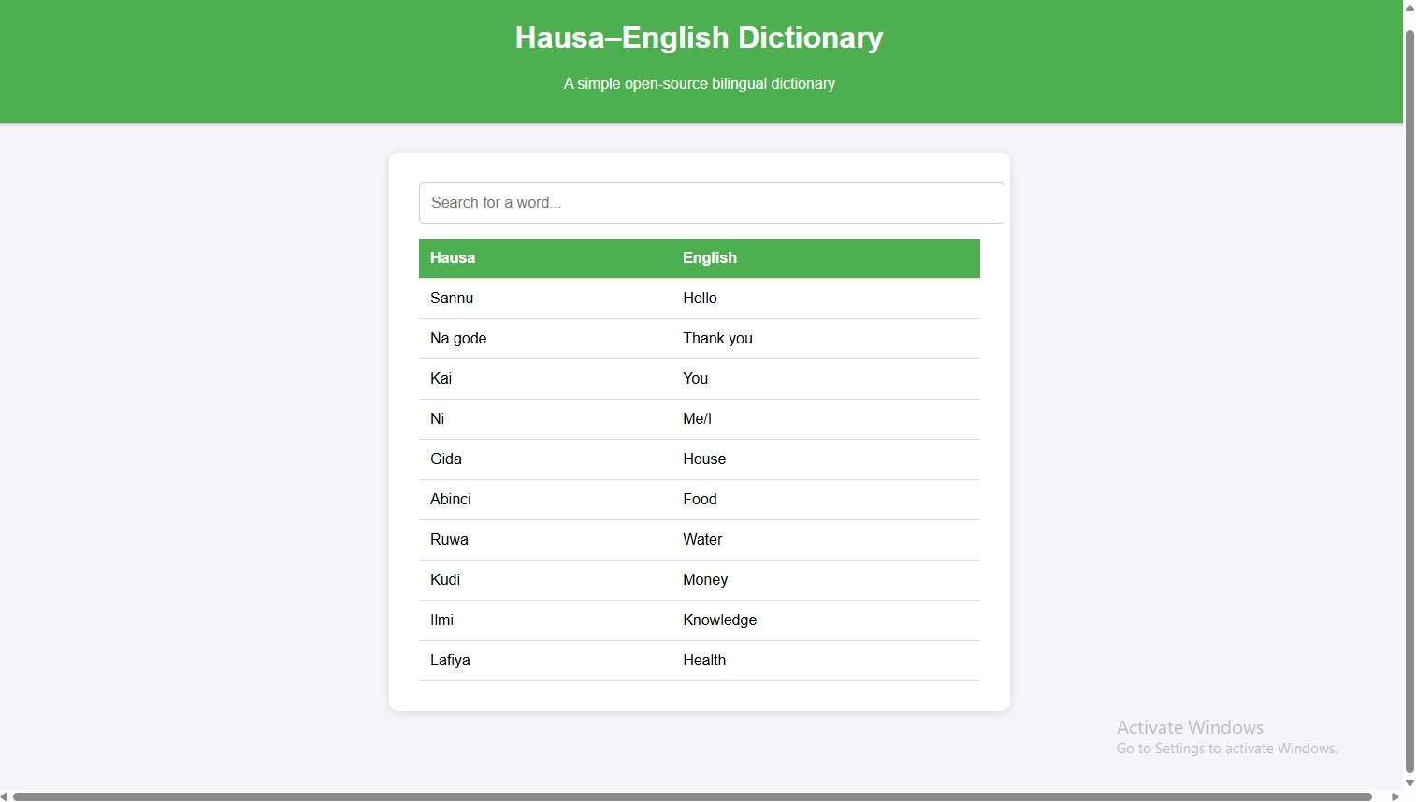
Screenshot

Slide 8
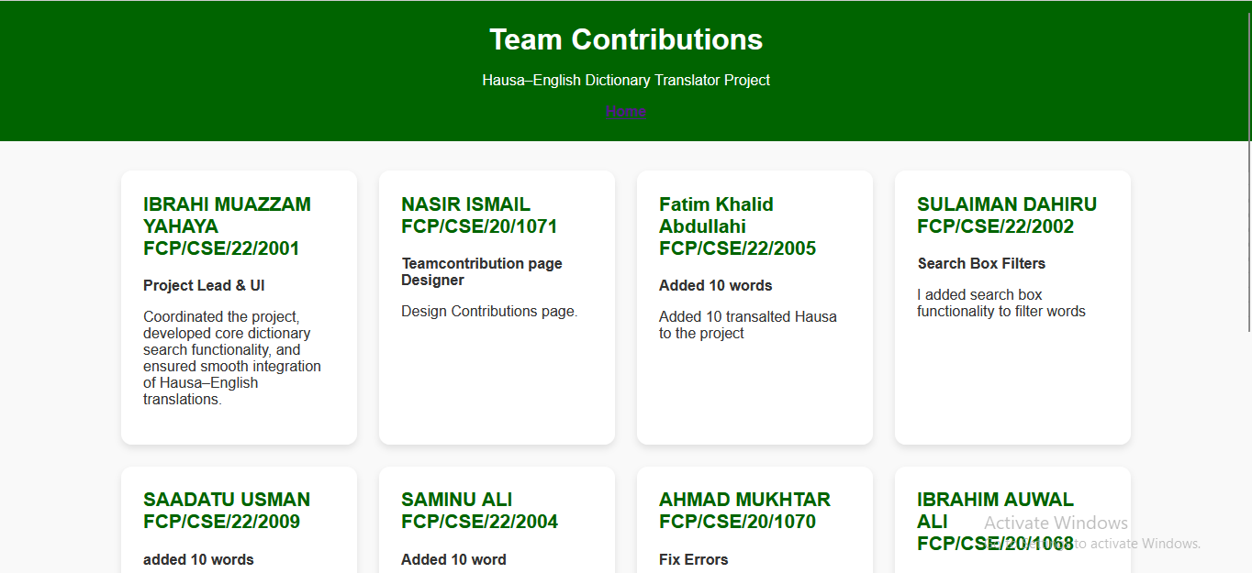
Screenshot

Slide 9
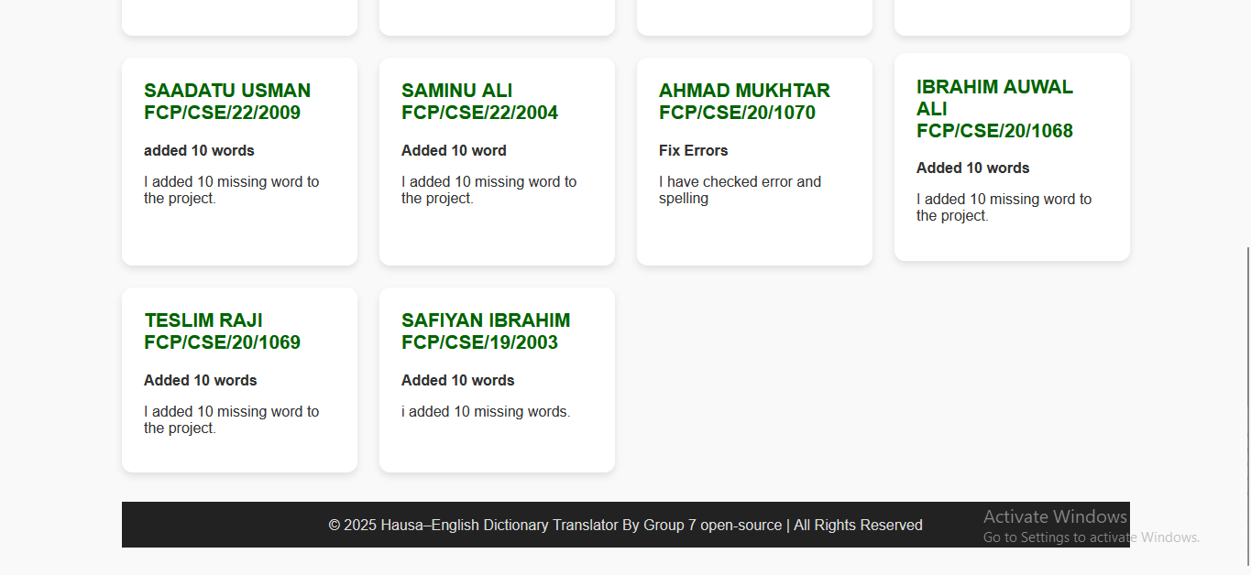
Screenshot

Slide 10
Project Activities & Timeline (3 Weeks)
Week 1: GitHub setup, LICENSE, README, add sample words.
Week 2: CSS styling, JS search, CONTRIBUTING.md.
Week 3: Test, refine, host on GitHub Pages, prepare slides & demo.

Slide 11
Contribution Plan
• Member 1: HTML structure.
• Member 2: CSS styling.
• Member 3: Add starter words.
• Member 4: Documentation.
• Member 5: JS search function.

Slide 12
License
• MIT License.
• Simple and permissive.
• Encourages reuse and contributions.

Slide 13
Expected Deliverable s
• GitHub repo with HTML, CSS, optional JS.
• README.md, LICENSE, CONTRIBUTING.md.
• Starter dictionary dataset (JSON/CSV/table).
• Commit history from all members.
• 10–12 PowerPoint slides.
• Live app hosted on GitHub Pages.
• Final 10-minute demo.

Slide 14
Thank You
Questions & Feedback

